Slide 1
Lab 2 - EEG classification
腦波訊號
偵測人類腦波，看你到底在想啥
Department of Computer Science, NCTU
TA Yu-Chuan Chuang

Slide 2
Important Rules
Important Date :
Report Submission Deadline: 4/11 (Thu) 12:00 p.m.(中午12點)
Demo date: 4/11 (Thu)
Turn in :
Experiment Report (.pdf)
Source code (.py)
Notice: zip all files in one file and name it like「DLP_LAB2_your studentID_name.zip」, ex: 「DLP_LAB2_0656608_莊祐銓.zip」

Slide 3
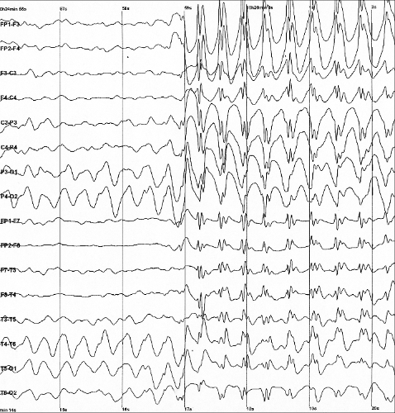
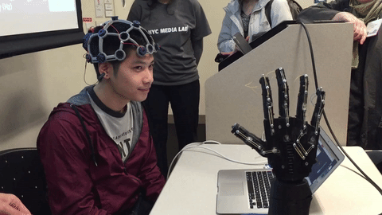
Lab Objective
只要直接READ BCI competition dataset
In this lab, you will need to implement simple EEG classification models which are EEGNet, DeepConvNet[1] with BCI competition dataset. Additionally, you need to try different kinds of activation function including『ReLU』,『Leaky ReLU』, 『ELU』.

Slide 4
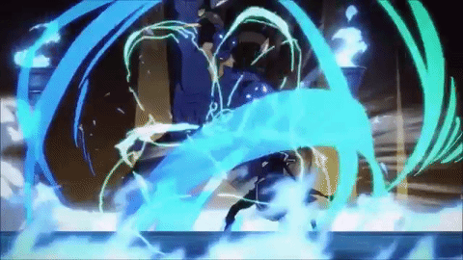

你想像的樣子
你實際的樣子

Slide 5
Requirements
Implement the EEGNet, DeepConvNet with three kinds of activation function including including『ReLU』,『Leaky ReLU』, 『ELU』.
In the experiment results, you have to show the highest accuracy (not loss) of two architectures with three kinds of activation functions.
To visualize the accuracy trend, you need to plot each epoch accuracy (not loss) during training phase and testing phase.

Slide 6
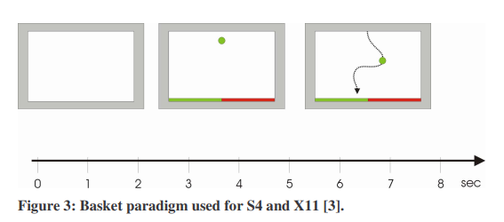
Dataset
BCI Competition III – IIIb
[2 classes, 2 bipolar EEG channels]
Reference: http://www.bbci.de/competition/iii/desc_IIIb.pdf

Slide 7
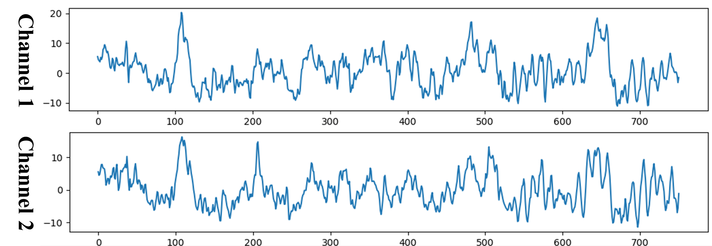
Prepare Data
Training data: S4b_train.npz, X11b_train.npz
Testing data: S4b_test.npz, X11b_test.npz
To read the preprocessed data, refer to the “dataloader.py”.
Input: [B, 1, 2, 750] Output: [B, 2] Ground truth: [B]
用NUMPY做
B: batch size
一維

Slide 8
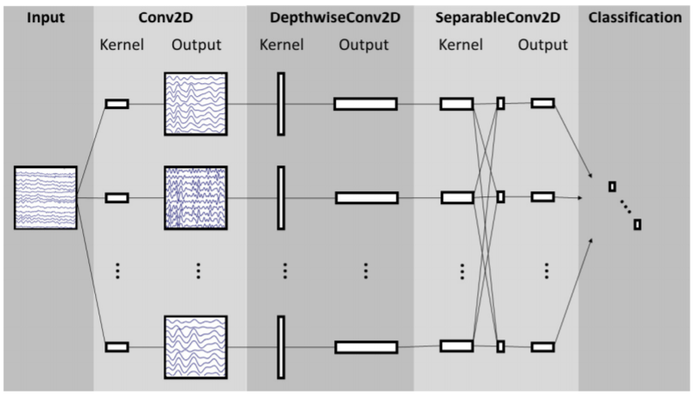
Create Model - EEGNet
自己研究….
Reference: Depthwise Separable Convolution
https://towardsdatascience.com/a-basic-introduction-to-separable-convolutions-b99ec3102728

Slide 9
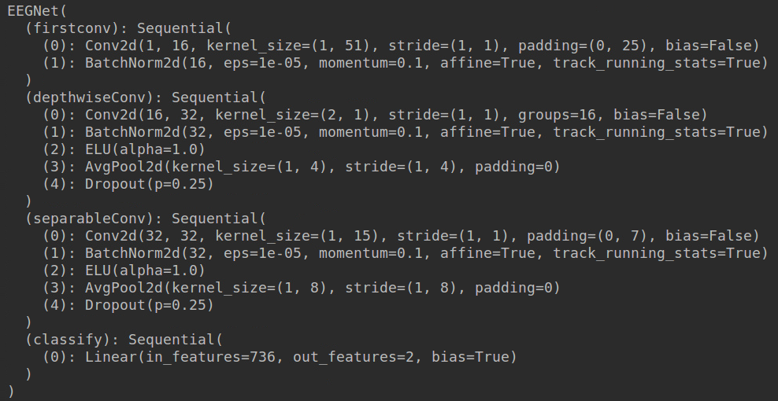
Create Model - EEGNet
EEGNet implementation details

Slide 10
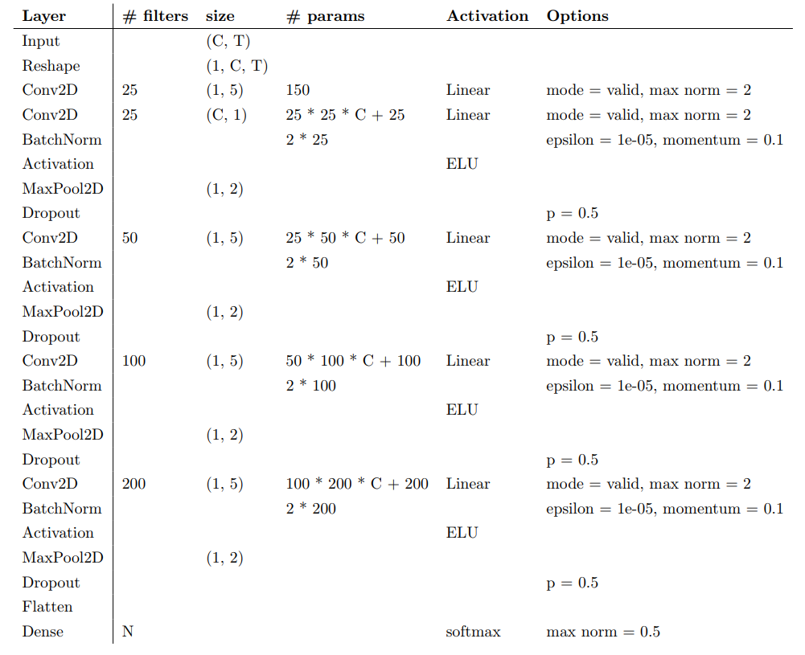
Create Model - DeepConvNet
You need to implement the DeepConvNet architecture by using the following table, where C = 2, T = 750 and N = 2. The max norm term is ignorable.
The input data has reshaped to [B, 1, C, T]

Slide 11
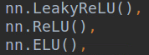
Create Model - Activation Functions
In the PyTorch framework, it is easy to implement the activation function.

Slide 12
Hyper Parameters
Batch size= 64
Learning rate = 1e-2
Epochs = 150
Optimizer: Adam
Loss function: torch.nn.CrossEntropyLoss()
You can adjust the hyper-parameters according to your own ideas.
If you use “nn.CrossEntropyLoss”, don’t add softmax after final fc layer because this criterion combines LogSoftMax and NLLLoss in one single class.

Slide 13
Result Comparison
You have to show the highest accuracy (not loss) of two architectures with three kinds of activation functions.
 | ReLU | Leaky ReLU | ELU
EEGNet | 85.33% | 84.63% | 82.93%
DeepConvNet | 82.75% | 86.33% | 85.73%

Slide 14
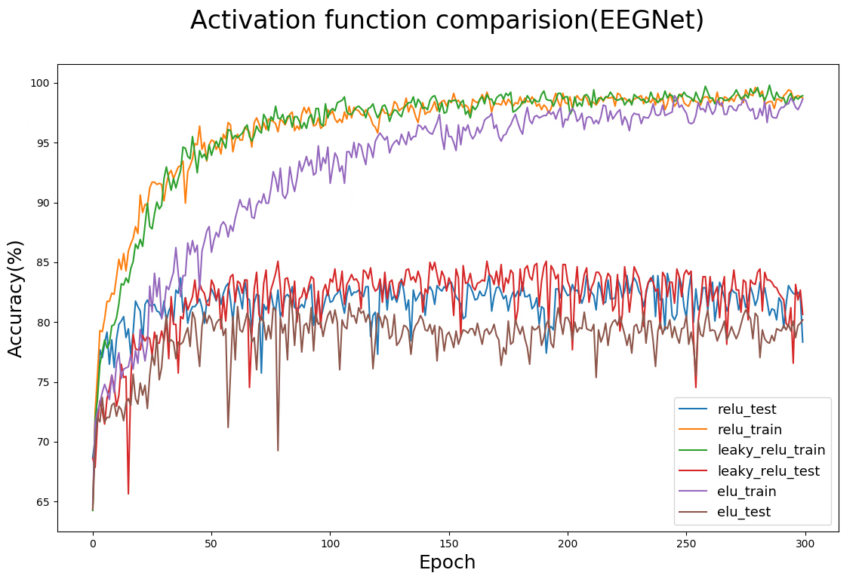
Result Comparison
To visualize the accuracy trend, you need to plot each epoch accuracy (not loss) during training phase and testing phase.
In this part, you can use the matplotlib library to draw the graph.
有6條線，包含TEXT和TRAINING

Slide 15
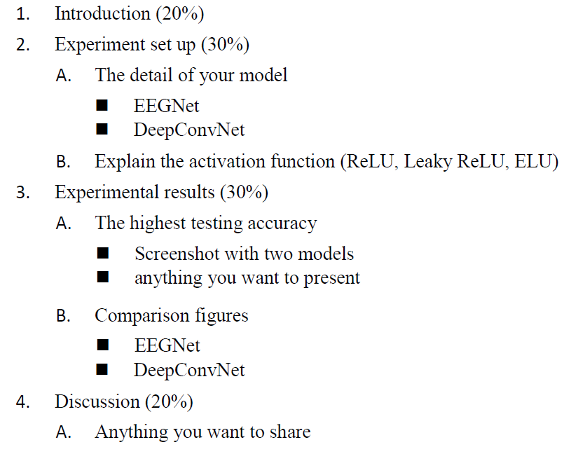
Report Spec

Slide 16
---- Criterion of result (40%) ----
Accuracy > = 87% = 100 pts
Accuracy 85~87% = 90 pts
Accuracy 80~85% = 80 pts
Accuracy 75~80% = 70 pts
Accuracy < 75% = 60 pts
Score: 40% experimental results + 60% (report+ demo score)
P.S If the zip file name or the report spec have format error, it will be penalty (-5).

Slide 17
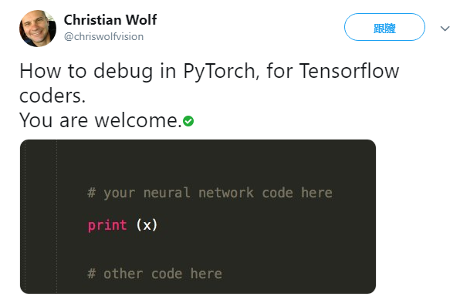
How to Debug?
Data shape or type mismatching?
Data shuffle in training?
Wrong on layer setting?

Slide 18
Reference
[1] EEGNet: A Compact Convolutional Neural Network for EEG-based Brain-Computer Interfaces

